Slide 1
Where to go & How to do it

Slide 2
Agenda
Limited Submissions
InfoReady
Pivot-RP
Demo of Pivot’s features and functionality

Slide 3
Limited Submissions​
Limited Submissions (LS) are funding opportunities in which the sponsor only allows a specific and limited number of proposals from a given institution.

Slide 4
How to find limited submissions
Limitations are always found in the solicitation (usually under eligibility information)
-PI limitations and Institutional limitations
Email from the Office of Research Development (ORD) to Associate Deans for Research (ADR’s) and Grants and Contract Specialists (G&C’s).
Posted on the Office of Research and Economic Development (ORED) website
-Initiatives tab → Limited Submissions
-Quick links

Slide 5
Limited Submission Process
Announcements are distributed via email which include all internal, pre-proposal requirements (due date included)
There is a link provided in the email that can take you directly to the InfoReady portal, specific to that solicitation, which is where all internal competitions are applied for and collected.
You can also find the InfoReady portal at the top of the ORED Limited Submission page on their website.
InfoReady

Slide 6
Things to keep in mind
It is the responsibility of the MSU employee (faculty, researcher, center director, etc.) to notify ORD if they identify a proposal announcement that has a limit on the number of proposals that can be submitted.
When multiple pre-proposals are received, ORD will convene a panel to review pre-proposals to determine which proposal has the best opportunity for funding.
Once a decision is made, the principal investigator (PI) of the pre-proposal is notified that they will represent MSU for the submission and an ORED approval number is provided.
The ORED approval number must be provided to the Office of Sponsored Projects (OSP) for the proposal to be submitted to the funding agency.
A PI of a pre-proposal that has been approved to represent the university should notify ORD if for some reason they decide not to submit a proposal for the limited submission. This will allow ORD to notify the second highest scoring preproposal applicant to submit on behalf of MSU.

Slide 7
PIVOT-RP
Find Funding
Advance Collaborations​
Increase Communications
Pivot-RP is a dynamic, comprehensive tool that will allow the following:
Search for funding opportunities ​
Track and save funding searches
Easily share opportunities with colleagues​
Explore profiles to advance potential collaborations
Extend communication and outreach
Receive email updates and notifications
Stay on top of funding insight

Slide 8
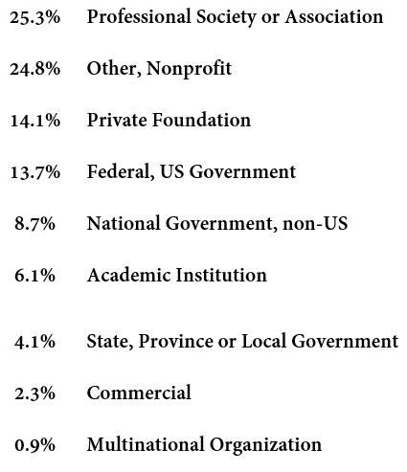
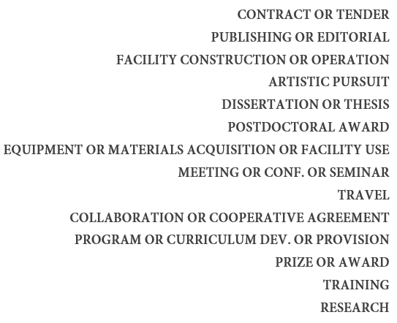
Finding funding Don’t miss an opportunity
Pivot provides a wide distribution of SPONSORS and a wide variety of opportunity TYPES all from one location!!

Slide 9
2 simple ways to Create an Account
Link to MSU dashboard:
https://pivot.proquest.com/dashboard ​
Office of Research Development website:
https://www.ord.msstate.edu/
Select “Create an Account”
Use Institutional Login Credentials (or) Use email Address/Create Password
Affiliate with MSU
Complete requested information (basic)
Receive a confirmation email from Pivot and select “Confirm”.
Sign in and claim or create your personalized profile
Side Notes
This is a FREE resource to all MSU faculty, staff, and students
Your email MUST be affiliated with MSU (office email OR netid@msstate.edu
This email will be your USER ID when signing in

Slide 10
Pivot- DEMO https://pivot.proquest.com/dashboard

Slide 11
THANK YOU
Kristen Sendelweck​ Kristen@ord.msstate.edu 662-325-3486

Slide 12
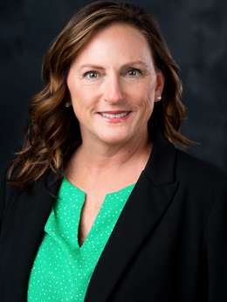
GOVWIN IQ
Denise Navicky
Aviation Program Manager
denise@raspet.msstate.edu

