Slide 1
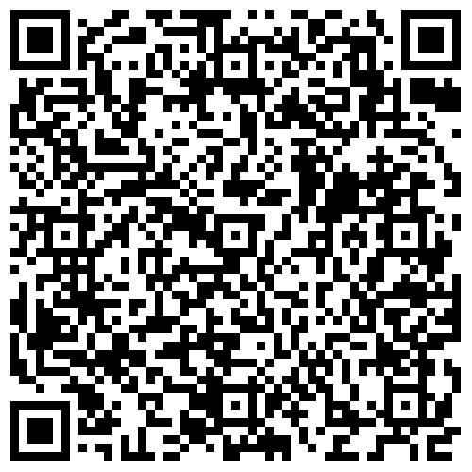
Finding funding 101: Tools, Resources & Strategies for Identifying Funding Opportunities The Office of Research Development 1.30.2024

Slide 2
Today’s Topics: strategies for Identifying Funding Sources Institutional Resources & supports Tools for Getting started
BEFORE WE BEGIN…
Q&A
Recording & Slides
Evaluations
Upcoming Events

Slide 3
GRANTSMANSHIP = Compelling, Competitive, Compliant
A good idea is the core of a grant application…but it isn’t enough.
Not only must the idea be innovative, impactful, and capable of advancing the state of knowledge, but the proposal must be compelling, well-written, and comply with levels of regulations.
Your idea alone does not merit funding. To merit funding, the idea must be closely aligned with the agency’s mission, strategic plan, and investment priorities.
Writing a proposal is a craft, not a science. Each project must take into account organizational, cultural, interpersonal dynamic factors.
Grantsmanship is knowing these things and recognizing that they matter.

Slide 4
Finding the right Source… In a NutshelL what they don’t teach You in Graduate School…..
The hardest and most time-consuming
part of developing a funding proposal isn’t always the writing…..
often it is finding the right funding source!
*It could literally be a full-time job in itself!

Slide 5
Prepare to spend time:
Conducting HONEST self and institutional capacity assessments
Examining trends in administrative and legislative policy and priorities (current affairs/ political climate and leverage)
Investigating agency priorities/ themes / previous projects that the agency has funded (contacting program officers, webinars, conferences & meetings, visiting!)
Learning about the grant forecasts and standard “drop” dates/cycles
Networking - Who at my institution/in my circle has received funding from this funder and knows about this funder’s priorities & opps?
Making friends in with your support services! Know your “team!”

Slide 6
About us…
Office of Research Development
Services by request and referral
Strategic planning for proposal development and aligned with goals of MSU, ORED, and unit
Preparation and management of RFP-specific development outlines and timeline
Team building and coordination of proposal assignments
Facilitate resources for pertinent data/services/collaborators (ex: community, institution, demographic, student, evaluation, stakeholder engagement, consultants, etc.)
Provide templates and boilerplate language for narrative components and supplemental documents, when available
Editorial, formatting, stylistic reviews; including facilitation of peer/technical review
Review for compliance with review criteria, agency guidance, and sponsor’s funding priorities
Serve as a liaison between PI/Department and OSP regarding processes and policies

Slide 7
What do you need funds for? Assessing your NEED
Depends on nature of the project – Research v. Programmatic v. Other/Special
Release Time – what is “buyout?”
Time/effort of project personnel/ collaborators, support staff if allowable
Travel
Undergrads/graduate students (salary, fringe, tuition, insurance)
Materials/supplies
Equipment
Other (participant costs, outreach, contracts, dissemination, conferences, etc. or maybe you just need submissions?)

Slide 8
Do you have a Funding Agenda? Assess Readiness and Capacity
What are your college/department expectations of you?
Can you provide strong evidence that you (and your team) are experienced, capable, and have the resources necessary for the work?
Where are you best equipped to contribute (PI, partner, consultant?)
Have you identified the Institutional support needed? (leverage, legacy, administration)
What do you need funds FOR? (think outcomes, not commodities for each line item)
Where does your work fit in the big picture? Who benefits? (funders’ priorities, etc.)
Where does it fit in YOUR big picture? What are your professional goals?

Slide 9
***Institutional Capacity – Centers as Central Resources
What can MSU’s Centers and Institutes do for you?
Evaluation and assessment services
Technical and service contractors/consultants
Data Sources & Data Analytics
Collaborator ID
Presenters and Subject Matter Experts
Curriculum Development
Project Evaluation
See the list of MSU Centers and Institutes: https://www.research.msstate.edu/ci/

Slide 10
Primary Sources for Funding Opportunities
Comprehensive databases
Federal & State agencies & organizations
Previous funders of mentors, colleagues, and peers
Industry contacts (pursue unsolicited opportunities)
Foundations
Professional/ academic/ advocacy organizations
Other institutions (IHLs, CCs, university centers, etc.)
Think outside of the box!!! Consider service/educational projects AND technical/industry/corporate partners

Slide 11
Understanding the Funders & Priorities
Beyond knowing policies and procedures, why do agencies fund what they fund?
Trends and timeliness – where and how to look
Agency strategic plans and “new” programs, “hot” topics, “Grand Challenges”
Legislation- federal and state budget requests/appropriations; what issues are prioritized?
The Federal Register, advocacy organizations, educational (general) and discipline –specific literature/journals
Understanding the legislative processes affecting funding streams – where to find info
Who are the major players? Who’s who in policymaking? Squeaky wheel?
Who already gets the money? Competitive? Formula?
Read press releases from legislators; attend town halls; visit while in DC; hint: staffers are key.

Slide 12
Understanding the Processes and Resources
What can you glean from agency/funder resources?
Agency cycles and forecasting
Know the basics. Take time to learn about standard funding mechanisms and standard lingo
Some projects are announced annually, some are on a rotation. When you know of a perfect opportunity, make note of when it will roll around again.
Where to get “inside” info?
working the system via agency personnel (program officers, reviewers, preferred contractors)
Abstracts, locations, and contact info for what has previously been funded
Archived webinars and conference programs
Data Sources & proposal prep guidance
Follow the rabbit hole…

Slide 13
Agency/Funder mission and culture
Federal (and other) grant programs are a means of producing an impact…influencing change.
Find out what they value.
Do they want partnerships?
Innovation? Commercial or dual use technologies?
Advancement of knowledge?
Pipeline for future?
Specific outcomes/deliverables?
Preliminary data?
Really do your homework here.
You will need to know as much as you can about the funder to be successful.
Notes:
For example, the National Science Foundation, requires applicants to address (and reviewers to evaluate) explicitly the broader impacts that the funded activities will have on society, including teaching and enhancing participation of individuals identified as ‘under-represented’ by virtue of their gender, ethnicity, geographic location, or any number of other demographic characteristics. As citizens of a society, scientists may have opinions regarding such issues, but not the objective expertise to evaluate the proposed impacts in this category.

Slide 14
Strategies for Success
Pick a few appropriate funders on which to focus but stay alert to others.
Develop & maintain relationships – Collaborations and networking are KEY!
Search with focus and consistency – direct via the agencies or using a search engine/tool.
Constantly scan – ½ hour per day – lists, eNewsletters, alerts, institutional resources
Keep a journal or spreadsheet of info on grants/partnerships, etc. noting award cycles
Consider preparing an unsolicited proposal – or at least prepare a white paper(s)

Slide 15
Collaborating for success
Use support networks to your advantage (OSP, ORED, library, advancement/foundation staff can facilitate introductions)
Stretch your associations – look for collaborators from diverse backgrounds (institutionally, geographically, interdisciplinary, culturally, etc.)
Consider being a consultant, evaluator, sub-awardee, etc.
Explore institutional working groups and cross-disciplinary events
Network at meetings of professional, social, honorary organizations.
Attend events & programs outside of your primary interest areas.

Slide 16
Our “Go-To” sites
https://www.grants.gov – Grants.gov
https://www.fbo.gov – Federal Business Opportunities
https://govwiniq.com – GovWinIQ Federal Contracting Opportunities
https://pivot.proquest.com – Pivot Funding Finder
http://www.federalregister.gov – Federal Register
http://www.chronicle.com/ - The Chronicle of Higher Education
https://www.ord.msstate.edu/ – Office of Research Development

Slide 17
You get a link…..you ALL get LINKS!!!!!

Slide 18
Federal Agencies
Institute of Education Sciences – www.ies.ed.gov
Institute of Museum and Library Services - www.imls.gov
National Aeronautics and Space Administration - www.nasa.gov
National Archives and Records Administration www.archives.gov
National Council on Disabilities - www.ncd.gov
National Endowment for the Arts - www.arts.gov
National Endowment for the Humanities - www.neh.gov
National Institutes of Health – www.nih.gov
National Science Foundation - www.nsf.gov/funding
Small Business Administration - www.sba.gov

Slide 19
Federal Agencies cont.
US Agency for International Development - www.usaid.gov
US Department of Agriculture - www.nifa.usda.gov/grants
US Department of Commerce - www.commerce.gov
US Department of Health and Human Services - www.hhs.gov
US Department of Defense - https://www.defense.gov/News/Contracts/
US Department of Education – www.ed.gov
Mississippi IHL: http://www.ihl.state.ms.us/
US Department of Energy - www.energy.gov

Slide 20
Federal Agencies cont.
US Department of Homeland Security – www.dhs.gov/how-do-i/find-and-apply-grants
US Dept. of Housing &Urban Dev. - www.hud.gov
US Department of Interior - www.doi.gov
US Department of Justice - www.justice.gov
US Department of Labor - www.dol.gov
US Department of State - www.state.gov
US Department of Transportation - www.dot.gov
US Department of Veterans Affairs - www.va.gov
US Environmental Protection Agency - www.epa.gov

Slide 21
A Sampling of Others
Center for Disease Control – www.cdc.gov
National Park Service – www.nps.gov
U.S. Fish and Wildlife Service – www.fws.gov
U.S. Geological Society – www.usgs.gov
Oak Ridge National Laboratory – www.ornl.gov
Oak Ridge Institute for Science and Education https://orise.orau.gov/
State Agencies – many accessible via federal counterpart – education, transportation, labor, etc.)
Regional Commissions (ex: Delta Regional Authority, Appalachia Regional Authority)

Slide 22
Foundations/non-profit/ Consortia sources of note
The Kellogg Foundation - https://www.wkkf.org/grants
The Gates Foundation – http://www.gatesfoundation.org
The Spencer Foundation – http://spencer.org
The Ford Foundation - https://www.fordfoundation.org/work/our-grants/
Howard Hughes Medical Institute – www.hhmi.org
The Field Museum – www.fieldmuseum.org
Smithsonian Museums – www.si.edu
Gulf of Mexico Research Initiative – www.gulfresearchinitiative.org
American Heart Association – www.heart.org
Robert Wood Johnson Foundation – www.rwjf.org
MSU Foundation Corporate and Foundation Relations and YOUR college’s development officer can help!

Slide 23
Notable corporate grantmakers
Target
Walmart
Dollar General
PepsiCo
Coca-Cola
Wells Fargo
State Farm
Tyson Foods
ExxonMobil
PNC Financial
Chevron
Goldman Sachs
Pfizer
JPMorgan Chase
Microsoft
Google
Citigroup
Merck
AT&T
General Mills
Kroger
Morgan Stanley
NOTE! If a company has a professional sports facility named after it, there is a pretty good chance it offers grants!

Slide 24
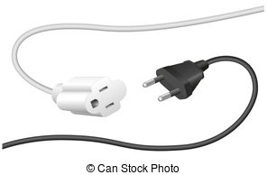
Industry & Commercial Partner resources
MURA – Mississippi University Research Authority (state specific consortium)
In-Part – Connecting University Technologies with Industry Partners (www.in-part.com)
UIDP - University Industry Demonstration Partnership (www.uidp.org)
MSU’s Office of Technology Management
STTR/SBIR, technology transfer, industry relations, economic development, Intellectual Property, licensing office)
Jim Martin – jimmartin@research.msstate.edu
Associate VP for Corporate Engagement
Office of Research & Economic Development

Slide 25
Communicating with program personnel
Why reach out to program officers/representatives?
Key to funding is building relationships
Gain insight on the funder’s current funding priorities – which can shift over time in-between published materials
POs can assist with determining the correct track for a proposal
*they know which of their peers has more flexibility with funding!
Program officers are typically rotating employees within agencies

Slide 26
A note about advocacy
Hone your message and be prepared for opportunities to share it. It is not enough to be the expert in your field, you must be able to communicate your expertise to make an impact.
What motivates the policy maker/stakeholder(s)?
How does what you/we do help them?
What is your “problem” and why is it important to the stakeholder?
What is the severity of it and who or what defines that?
What are the consequences of your problem not being addressed?
What constituency(ies) do you represent to the stakeholder?
Who in their circle of influence is accessible?
Understand their jargon but avoid yours.

Slide 27
INTERNAL FUNDING SOURCES
Office of Research & Economic Development
Advancing Collaborative Research Funds (look for announcement late spring)
Undergraduate Research Program
Support for writing for The Conversation
Annual Research Awards honoraria
New programs TBA
The International Institute
Global Development Seed Grants

Slide 28
Other Central support units
Sponsored Programs Accounting – www.controller.msstate.edu
Office of the Graduate School – www.grad.msstate.edu
Office of the Provost – www.provost.msstate.edu
MSU Libraries – www.library.msstate.edu
Division of Access, Diversity & Inclusion - www.adi.msstate.edu
Office of Institutional Research & Effectiveness – www.ir.msstate.edu
MSU Foundation – www.msufoundation.com
Center for Entrepreneurship & Outreach – www.ecenter.msstate.edu

Slide 29
Resources 101 Tools, templates, samples & subscriptions
Carmen Arrigo
01/30/2024

Slide 30
Agenda
MSU Tools for Grantseekers developed by ORD (Website Overview + TOPS)
MSU Subscribed Services (Hanover, Pivot, Gov.win)
MSU Staff (ADRs, Grants & Contracts, Business Mgrs., ORD)
Funding Opportunity Announcements & Internal Opps (OpsWatch, Fuller, International, TOPS, DDD Listserv, Academic Research Funding Strategies, LLC, ORED Opps)
Other MSU Support Units (SPA, OSP, Graduate School, Provost, General Counsel)

Slide 31
MSU Tools for Grantseekers developed by ORD
We try our best to keep a variety of resources available for faculty use on our website.
Here you can find in-depth information on the services ORD offers, where and how to find funding, toolkits and templates for proposal prep, upcoming education and events, and the ORD staff.

Slide 32
(tops) Targets of opportunity
Sent out at the beginning of each month, TOPS is a newsletter with curated grants that we think the MSU community might find interest in.
It also contains highlights of staff achievements, upcoming events (institutional and external), entrepreneurship opportunities and pitch competitions, reviewer opportunities, federal and other grant-related webinars, and the contact list for campus Grants and Contracts personnel.

Slide 33
MSU Subscription Services
MSU pays for several services so that they are FREE for you!

Slide 34
Subscribed services
A grant search tool (federal, state, foundation, private)
Can help connect you to collaborators
Can save curated searches to be delivered to email
And more! Kristen is our Pivot Guru.
Hanover Research makes market research accessible to all using the latest research methodologies that deliver outstanding value and measurable impact.
Early Career & Healthcare Deadlines Calendars
Webinars, etc. – just email development@ord.msstate.edu if you’re interested in a topic!

Slide 35
Funding opportunity announcements
TARGETS OF OPPORTUNITY (TOPS) Sent at the beginning of each month, TOPS contains a few curated funding opportunities along with upcoming federal and institutional professional development events geared for grantseekers, research administrators and adjacent positions.
GRANTWRITING NEWS Sent monthly, the Academic Funding Strategies, LLC, newsletter contains both articles and links to resources on the web, and includes topics of interest, funding opportunities, and writing tips related to the academic extramural funding landscape.
FULLER GRANT UPDATES Sent every Wednesday, this resource curated by Dr. Marty Fuller of Federal Solutions provides information about funding opportunities and meetings from various federal agencies of interest to the MSU community.
FULLER INTERNATIONAL FUNDING OPPS Sent every Friday, this grants update by Dr. Marty Fuller provides information from federal agencies that exclusively relate to the international world. These are not included in the regular fuller grant updates.

Slide 36
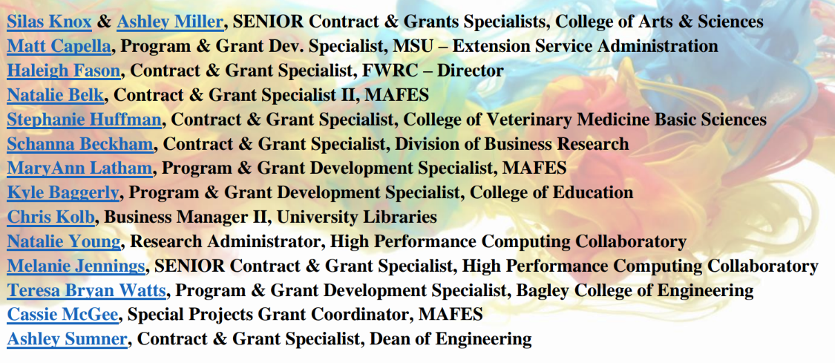
MSU Departmental Staff

Slide 37
Thank you
Carmen Arrigo| carmen@ord.msstate.edu | www.ord.msstate.edu

Slide 38
Tools & SYSTEMS
Limited Submissions
InfoReady
Pivot-RP
Demo of Pivot’s features and functionality

Slide 39
Limited Submissions​
Limited Submissions (LS) are funding opportunities in which the sponsor only allows a specific and limited number of proposals from a given institution.

Slide 40
How to find limited submissions
Limitations are always found in the solicitation (usually under eligibility information)
-PI limitations and Institutional limitations
Email from the Office of Research Development (ORD) to Associate Deans for Research (ADR’s) and Grants and Contract Specialists (G&C’s).
Posted on the Office of Research and Economic Development (ORED) website
-Initiatives tab → Limited Submissions
-Quick links

Slide 41
Limited Submission Process
Announcements are distributed via email which include all internal, pre-proposal requirements (due date included)
There is a link provided in the email that can take you directly to the InfoReady portal, specific to that solicitation, which is where all internal competitions are applied for and collected.
You can also find the InfoReady portal at the top of the ORED Limited Submission page on their website.
InfoReady

Slide 42
Things to keep in mind
It is the responsibility of the MSU employee (faculty, researcher, center director, etc.) to notify ORD if they identify a proposal announcement that has a limit on the number of proposals that can be submitted.
When multiple pre-proposals are received, ORD will convene a panel to review pre-proposals to determine which proposal has the best opportunity for funding.
Once a decision is made, the principal investigator (PI) of the pre-proposal is notified that they will represent MSU for the submission and an ORED approval number is provided.
The ORED approval number must be provided to the Office of Sponsored Projects (OSP) for the proposal to be submitted to the funding agency.
A PI of a pre-proposal that has been approved to represent the university should notify ORD if for some reason they decide not to submit a proposal for the limited submission. This will allow ORD to notify the second highest scoring preproposal applicant to submit on behalf of MSU.

Slide 43
PIVOT-RP
Find Funding
Advance Collaborations​
Increase Communications
Pivot-RP is a dynamic, comprehensive tool that will allow the following:
Search for funding opportunities ​
Track and save funding searches
Easily share opportunities with colleagues​
Explore profiles to advance potential collaborations
Extend communication and outreach
Receive email updates and notifications
Stay on top of funding insight

Slide 44
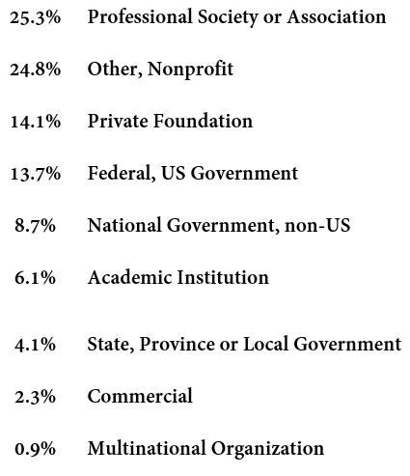
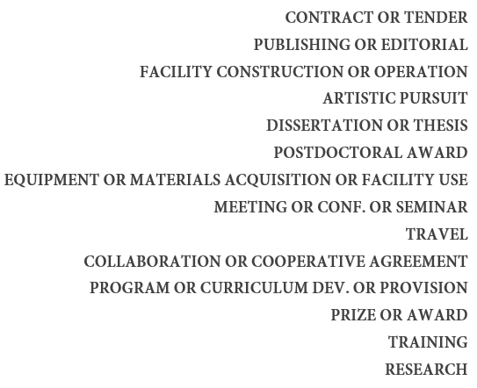
Finding funding Don’t miss an opportunity
Pivot provides a wide distribution of SPONSORS and a wide variety of opportunity TYPES all from one location!!

Slide 45
2 simple ways to Create an Account
Link to MSU dashboard:
https://pivot.proquest.com/dashboard ​
Office of Research Development website:
https://www.ord.msstate.edu/
Select “Create an Account”
Use Institutional Login Credentials (or) Use email Address/Create Password
Affiliate with MSU
Complete requested information (basic)
Receive a confirmation email from Pivot and select “Confirm”.
Sign in and claim or create your personalized profile
Side Notes
This is a FREE resource to all MSU faculty, staff, and students
Your email MUST be affiliated with MSU (office email OR netid@msstate.edu
This email will be your USER ID when signing in

Slide 46
Pivot- DEMO https://pivot.proquest.com/dashboard

Slide 47
THANK YOU
Kristen Sendelweck​ Kristen@ord.msstate.edu 662-325-3486

Slide 48
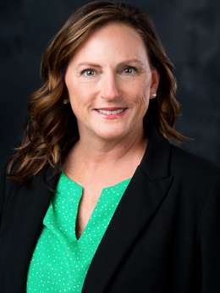
GOVWIN IQ
Denise Navicky
Aviation Program Manager
denise@raspet.msstate.edu

Slide 49
Now, GO Fetch some funding!

Slide 50
QUESTION TIME!

