Slide 1
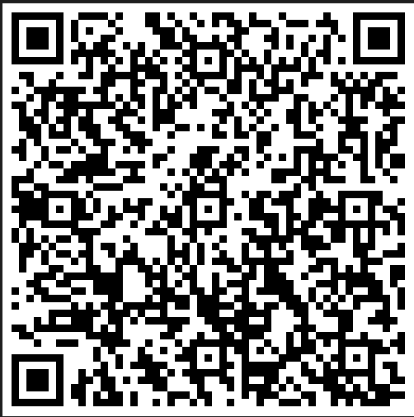
Driving Grant Funding through the Diversity & Inclusion Imperative
today’s resources
Fall 2023
Notes:
Delaney

Slide 2
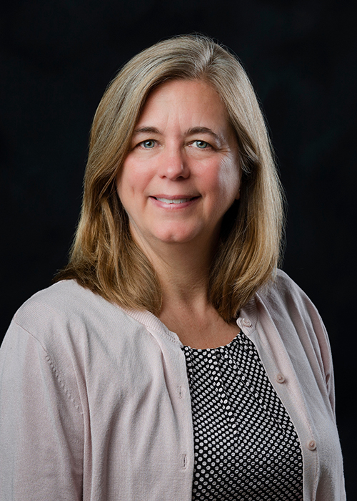
Dr Devon Brenner
Director, Social Science Research Center
Research focus on rural teacher recruitment & retention and rural education policy.
Notes:
Devon

Slide 3
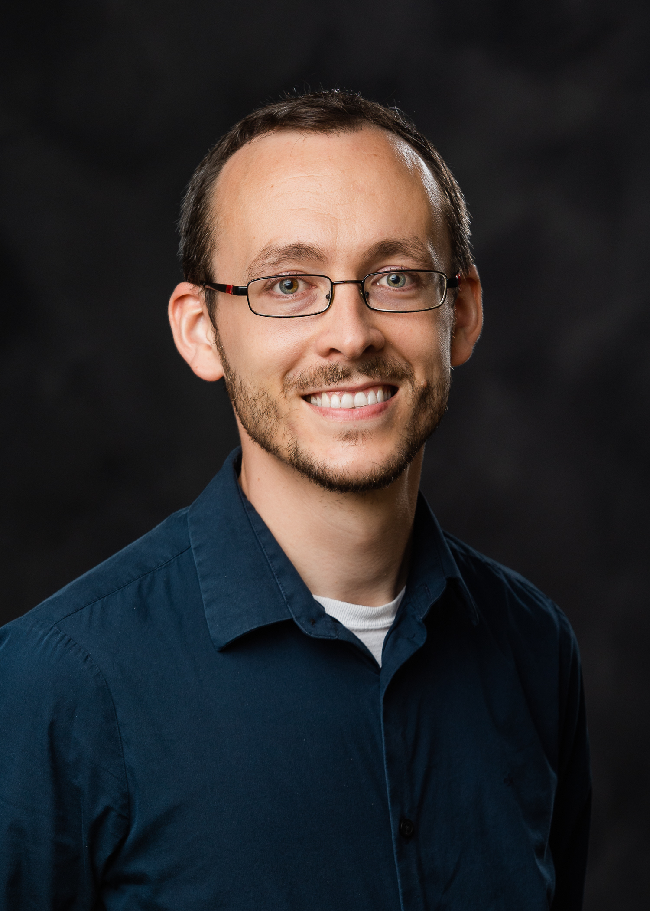
Dr. Ryan Folk
Assistant Professor, Department of Biological Sciences
Herbarium Curator
Documents the origins of plant diversity from evolutionary & ecological perspectives.
Notes:
Ryan

Slide 4
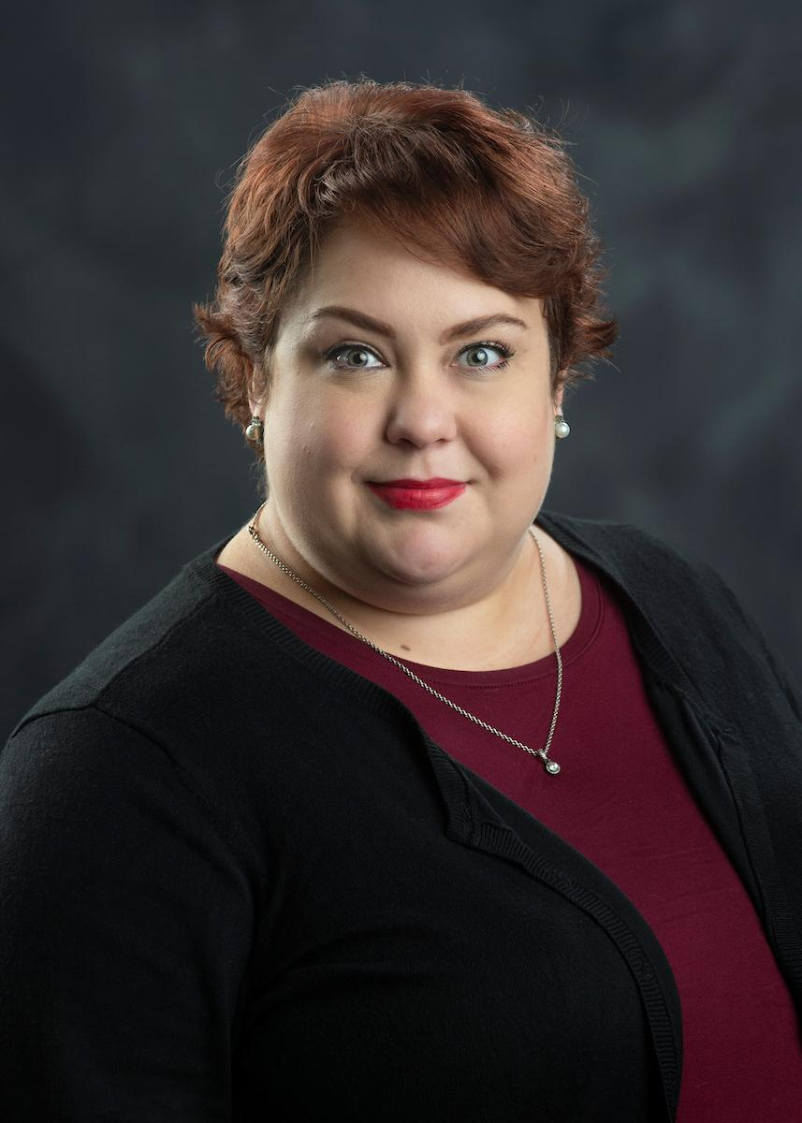
Delaney Foster
Interim Director, Office of Inclusive Excellence
Lead grant efforts on behalf of the Division of Access, Diversity & Inclusion.
Notes:
Delaney

Slide 5
01
02
Need at MSU: Faculty and student Data
Answering some questions
03
Faculty Perspectives
04
aDI Mission and REsources
Funder Imperatives--What Do Funders Want
Notes:
Delaney

Slide 6
What Do Funders Want?
Notes:
Delaney

Slide 7
Common Diversity Elements
Inclusive Recruiting Plan
Institutional plan or statement
Broader Impacts writing
PI Diversity statement
Workshops, Trainings, custom plans
Inclusive Environments Plan
Notes:
Delaney
Common “asks” in federal and other grants

Slide 8
NSF: Broadening participation
Increase Workforce Diversity
Create Inclusive Workforces
Develop leaders of the future
Recruit Underrepresented students
Workshops, Trainings, custom plans
Trainings, mentoring
Notes:
Top row is goals, bottom row is ideas
SSTEM, IUSE

Slide 9
Broader Impacts: Potential to benefit society and Contribute to the achievement of specific, desired societal Outcomes
NSF always, but increasingly other funders
Research itself contributes to societal problems or breakthroughs
Activities related to the research projects—often, training ground (e.g., for undergraduates or graduate students, early career scientists, REU, Postdoc mentoring plan)
Activities supported by an complementary to the project—educational workshops, teacher training, communicating science to broad audiences, etc.
Notes:
Devon

Slide 10
U.S. Department of Agriculture
Diversity is embedded in the mission
Robust equity action plan
$25 million right now for underserved groups
Special call for Rural learners & studies
Workshops, Trainings, custom plans
Special call for low-income learners
Notes:
Delaney
Top row is goals, bottom row is ideas

Slide 11
U.S. Department of Education
Ensuring equal access is key to the mission
Fostering diverse schools Grants
Teacher diversity is in top 3 priorities
Equal access can start with teacher education
Grants for partnerships with local schools
Help recruit & retain underrepresented students
Notes:
Top row is goals, bottom row is ideas

Slide 12
Basically everywhere

Slide 13
Discuss
How do these goals intersect with your own work?
Notes:
Let people turn and discuss
Share with the group
What are the funders you work with, how does this hit your research?

Slide 14
An effective grant proposal solves a problem or addresses a need
Notes:
People aren’t a problem- issues of access and opportunity are the problem. Changing demographics is the solution, and demographics can be a great place to start with identifying where growth should occur.

Slide 15
Who Are Our Students?

Slide 16
Undergraduate Demographics
35.7% are First Generation Scholars
25.5% of undergraduates are students of color
27.8% are Pell-Eligible
50.5% are women
23% of undergraduates meet NSF definition of “underrepresented”
Ms State Office of Institutional Research Public data, Fall 2022
Notes:
These are some of the demographics you may have thought of

Slide 17
Intersecting Identities
22% of STEM Majors are also students of color
8% have documented & registered disabilities
36% OF STEM Majors are First-Generation Scholars
44% of STEM Majors are Also Women
many Are from rural areas
Ms State Office of Institutional Research Public data, Fall 2022
Notes:
These are some that you may not have thought of
First Gen= first in family to earn a 4- year degree
Name some grants that are geared at women
27.8% name some grants geared at low-income students
These are all areas with funding

Slide 18
Other Groups
85% of students report being “very comfortable or comfortable” with classroom climate
69.4% OF Survey respondents are Christian
Nearly 1 in 6 are LGBTQIA+/Queer Community
71% of students feel that they have faculty role models
2021 Campus Climate Data
Notes:
Not in STEM? Not a problem
We can use campus climate aggregate data to point you towards interesting research

Slide 19
About our faculty
5.8% are international
24% are people of color
50% are tenured or tenure-track
45% are women
What is the promotion & tenure rate?
Ms State Office of Institutional Research Public data, Fall 2022
Notes:
These are some of the demographics you may have thought of

Slide 20
IntBIO
NSF special call – integrative research AND mentorship of underrepresented students
Needed something ambitious – call + POs made it clear this was a key component

Slide 21
IntBIO
Contacted ADI to manage BRIDGES and SREB programs – multiple levels of training pipeline
Focus on recruitment to success evaluation

Slide 22
More Interesting Research
NSF Teacher Preparation for Rural Teacher Persistence and Retention
Broader Impacts for CAVS DOD grant

Slide 23
How Can We Meet Funder Need?

Slide 24
Undergraduates
Inclusive Environemnts
Fuel Your Funding
Broader Impact Planning
Graduates
Recruit, retain, engage, employ
Prepare PIs, current team, future of your field
Social change and improvement is a product of nearly any people-centered research
Recruit, retain, engage, employee, postdoc mentoring plans

Slide 25
IntBIO
From panel summary:
"The Broader Impacts of this proposal are very strong integrating well defined training and mentoring programs with a strong component for broadening representation. The proposal additionally supported strong connections with an existing REU program."
""The proposal includes components of assessment […] and include very interesting indicators like actual recruitment of underrepresented minorities and long-term tracking of placement, in addition to surveys and interviews."

Slide 26
Who is ADI?

Slide 27
Mission & Vision
Our Mission
Our Vision
The Division serves as the institutional leadership on matters of access, diversity, and inclusion as they relate to the community and experiences of students, faculty, and staff at Mississippi State University.
Central to the university’s public, land-grant mission, the Division works to provide access and opportunity to a diverse population by infusing its core principles into institutional decision-making, processes, communications and initiatives.

Slide 28
Fulfilling Our Mission
Inclusion
Access
Expand Pathways that Drive Student Success
Enhance Campus Climate through Education
Expand pathways and services for support and care that enhance academic achievement, student development, persistence and degree completion
Enhance campus climate through educational and strategic initiatives
Diversity
Belonging
Recruit & Retain Diverse Faculty & Staff
Retain & Graduate
a Diverse Student Body
Bolster the identification, retention and promotion of diverse faculty, staff and administration
Compliment institutional efforts to identify, attract, retain, and graduate a diverse student body

Slide 29
Our Departments
Academic Access & Support
Holmes Cultural Diversity Center
Office of Inclusive Excellence

Slide 30
Undergraduate Engagement
bridges
lsmamp
Student Organizations
TRiO
Promise Program
RECRUITMENT
Undergraduate
research
STEM research & scholar development
Need student leaders?
Recruit & study students
Need Mississippi students?
We can connect you with students

Slide 31
graduate Engagement
SREB
BRIDGES
LSMAMP
NCFDD
Writing Circles
Socials
Dr. Harold Grier Doctoral Scholars
Recruit trained students into your programs
Recruit equipped STEM students as GAs
No-cost professional development
Increase output & form connections
Sense of belonging retains students

Slide 32
Inclusive Environments
Trained PIs
Safe Zone
Evaluation
Cultural Immersion
Inclusion Plans
Broader Impacts
Workshops & microcredentials
Demonstrate commitment to inclusion
No-PI Evaluators can be helpful
Help with preparing & evaluating
Social impact exists in every proposal
Educational & fun

Slide 33
Current Grant Funding
Academic Access & Success: TRiO
Holmes Cultural Diversity Center
Interfaith Initiatives
International Fiesta & Global Village
Division of Access, Diversity & Inclusion
Louis Stokes Alliance for Minority Participation (LSAMP)
IntBIO & BRIDGES
Office of Inclusive Excellence
IntBIO & Dr. Harold Grier Doctoral Scholars
Notes:
TRiO- Department of Ed
Interfaith Initiatives- Interfaith America
International Fiesta- MS Arts Commission
LSAMP- NSF
IntBIO- NSF with Ryan Folk

Slide 34
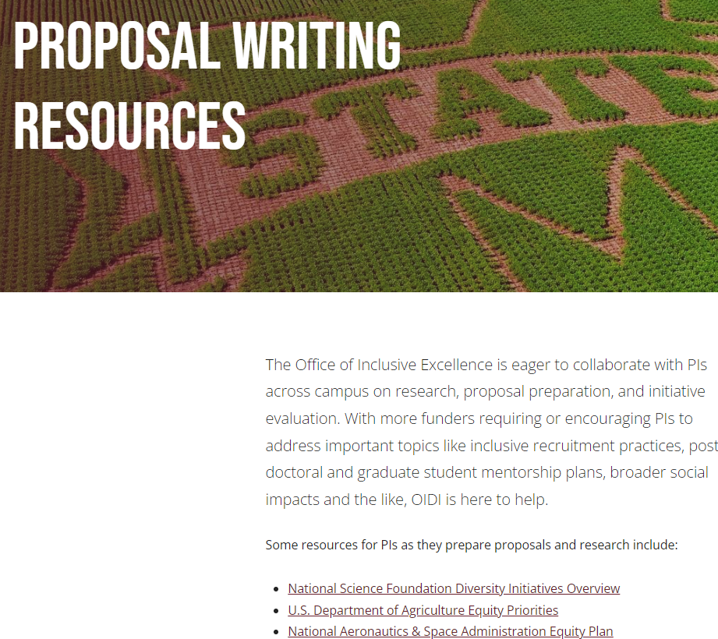
New resources on our website oidi.msstate.edu
Images reveal large amounts of data, so remember: use an image instead of a long text
Notes:
Plug the new site, talk about how this will be updated frequently

Slide 35
What Will You write For?
Turn & discuss

Slide 36
Questions

