Slide 1
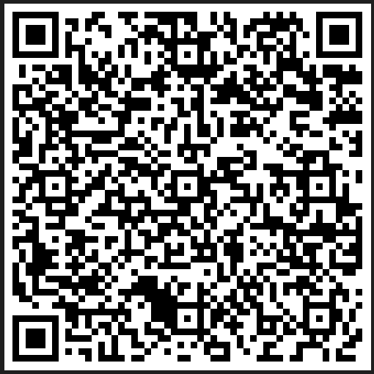
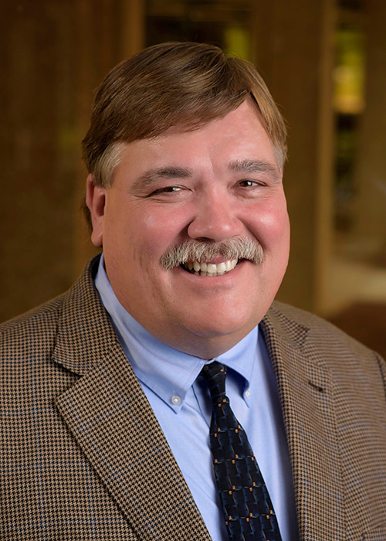
MSU Office of Research and Economic Development
Seminar Series
Tuesday, October 10, 2023
Find the handouts & resources from today’s program here!
Demonstrating Research Impact through Outreach and Engagement
Dr. Gary Jackson
Associate Vice President for Outreach and Engagement Professor of Agricultural Education and Communication

Slide 2
Demonstrating Research Impact through
Outreach and Engagement
Gary Jackson, Ph.D.
Associate Vice President for Outreach and Engagement
Professor of Agricultural Education and Communication
Fowlkes Auditorium | Colvard Union
October 10, 2023

Slide 3
The University’s Third Mission
The third mission….is extending education and service to citizens who are not resident at the Oregon State University’s campus, and which draws upon the knowledge base of the University.
John V. Byrne, President
Oregon State University, 1993

Slide 4
Outreach and Engagement Defined
Outreach and Engagement are two distinct ways for the university to connect to external individuals, groups, organizations, agencies, businesses, etc.
Outreach is one-way communication where the university faculty and staff provides information about an issue, problem, or opportunity. We typically describe this as public service.
Engagement is two-way communication and involves a deliberate, well-planned process where the university faculty and staff inform, involve and have participation from community or business. Engagement typically occurs through community-engaged research and non-formal (non-credit) teaching.

Slide 5
Ernest Boyer
United States Commissioner of Education
Chancellor of State University of New York (SUNY)
President of the Carnegie Foundation for the Advancement of Teaching
Developed the Boyer Model that ignited the outreach and engagement discussion in higher education. Observation, a steady decrease in the relevance on colleges and universities in society and called on higher education to “break out of the tired, old teaching versus research debate…The academy must become a more vigorous partner in the search for answers to our most pressing social, civic, economic and moral problems and must affirm it historic commitment to what I call the scholarship of engagement.”

Slide 6
The Scholarship of Engagement
Scholarship resulting from a collaborative and mutually beneficial partnership between university faculty, staff and students and external non-higher education partners. Engaged scholarship is typically created and communicated through the discovery of new knowledge, the development of new knowledge, dissemination of new knowledge, and a change in learning, behavior and/or condition (Franz, 2009).

Slide 7
Scholarship Reconsidered: Priorities of the Professoriate (Boyer, 1995)
New Paradigm of Scholarship (four functions)
  The Scholarship of Discovery – to observe and research phenomena to create new knowledge and add to the body of knowledge of a discipline.
  The Scholarship of Integration – to research, synthesize, evaluate and interpret the use of knowledge through an interdisciplinary approach, illuminating the data and focusing on a specialized need/areas.
  The Scholarship of Sharing Knowledge (Teaching) – to improve student learning through innovative instructional design, teaching methods and techniques, conducive learning environments, etc., that answer’s the “so what?” question. Includes non-formal or non-credit teaching. It also requires that the systematic study of teaching and learning and the work be made available to the public.
  The Application of Knowledge – applying research to address noteworthy problems that benefit society.

Slide 9
From a transformational perspective……. use Boyer’s Model to:
Connect discovery, integration, application and teaching to understanding and solving community and economic based needs.
The Scholarship of Engagement is the integration of research and education with community development that is directly applied to problems and issues facing individuals, local communities, stakeholder groups, organizations, businesses and government leaders.

Slide 10
NSF Core Values
Scientific Leadership
Integrity and Excellence
Diversity and Inclusion
Public Service
Innovation and Collaboration

Slide 11
Major Changes in Research
The application of research and the commercial frame. Research is not valued until it is used” (Nick Baker, Savanta, 2019).
Rethinking market research and how to engage with consumers to conduct it…” (Jane Rudling, Walnut Unlimited, 2019).
Technology as an enabler of new ways of engaging research participants and making data available faster….” (Sinead Jefferies, Research Consultant, 2019).

Slide 12
NSF Strategic Goals
Empower – STEM talent to fully participate in science and engineering.
Discover – create new knowledge about our universe, the world & ourselves.
Impact – benefit society by translating knowledge into solutions.
Excel – at NSF operations & management.

Slide 13
NIH Goals and Objectives
Foster fundamental creative discoveries , innovative research strategies and their applications as a basis for ultimately protecting and improving health;
Develop, maintain and renew scientific human and physical resources that will ensure the Nation’ capability to prevent disease;
To expand the knowledge base in medical and associated sciences in order to enhance the Nation’s economic well-being and ensure a continued return on the public investment in research; and
Exemplify and promote the highest level of scientific integrity, public accountability and social responsibility in the conduct of science.

Slide 14
USDA NIFA Goals
Invest in and advance agricultural research, education and extension to solve societal challenges.
Lead innovation across the nation through transformative discoveries, education and engagement that addresses agricultural challenges.

Slide 15
MSU Transformational Plan Goals 2023
Serve the whole student
Strengthen our bonds
Ignite Innovation
Elevate our community – serve our communities with the knowledge and experience that address critical challenges and unique opportunities.
Tell our story

Slide 16
MSU Task Force Recommendations
Recognize outreach and engagement as a critical element to the mission of the University.
Provide additional training and support for outreach and engagement.
Create a university infrastructure to support outreach and engagement.
Support, evaluate and improve outreach assessment and data collection.
Tell stories about MSU outreach and engagement.

Slide 17
MSU’s Outreach & Engagement Record
(A few highlights)
Carnegie Foundation for the Advancement of Teaching Community Engagement Classification
Research Projects & Programs with engagement through educational deliverables.
Federal Plan of Work Report for MSU Extension & MAFES
The CVM Annual Report
MSU Certification Programs (Credit and Non-Credit)
MSU Workshops, Short Courses, Seminars, In-service Trainings, etc.
MSU Faculty Consulting Projects
MSU Services (State Chem Lab, Transit System, etc.)

Slide 21



Slide 22
Thank you!
Gary Jackson, Ph.D.
Associate Vice President for Outreach and Engagement
Mississippi State University
3500 Lee Hall
262 Lee Boulevard
Mississippi State, MS 38762
662-325-3742
gbj2@msstate.edu

