Slide 1
Preparing the cyber workforce from kindergarten through career!

Slide 2
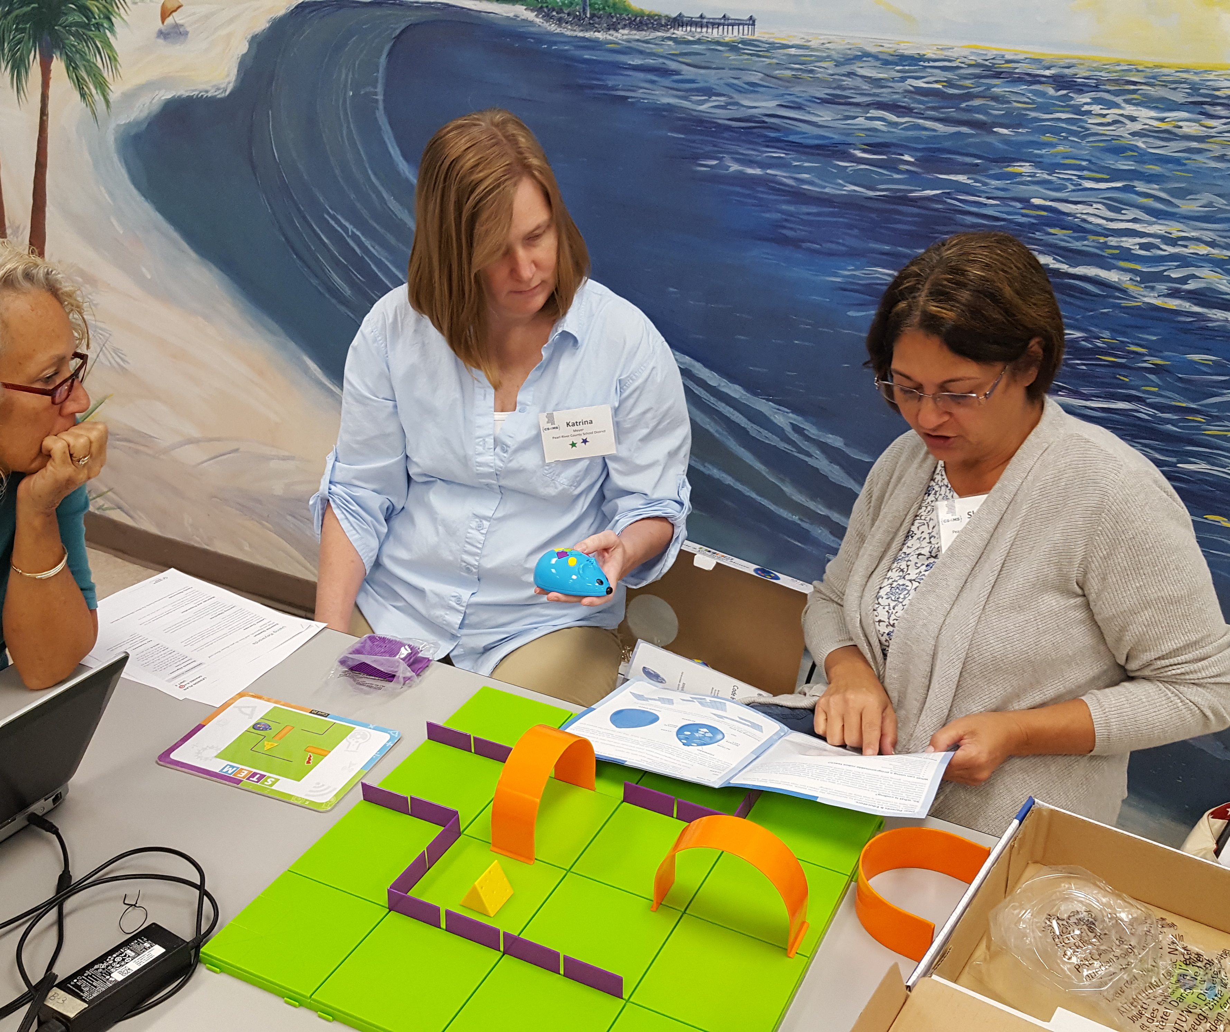
What we do
Conduct cybersecurity awareness training for small businesses
Host certification training to grow and strengthen the cybersecurity workforce
Lead K-12 computer science standards development and maintenance
Provide computer science professional development for K-12 teachers
Develop and maintenance of K-12 computer science curricula
Host computer science camps and outreach events for K-12 students
Develop industry partnerships to build stronger pipelines into the workforce
Promote diversity in computer science education and occupations

Slide 3
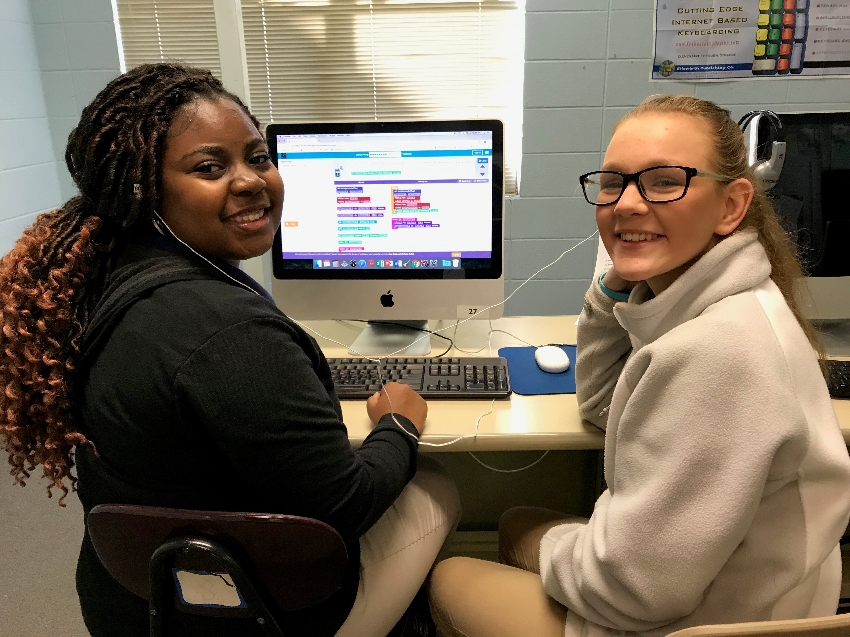
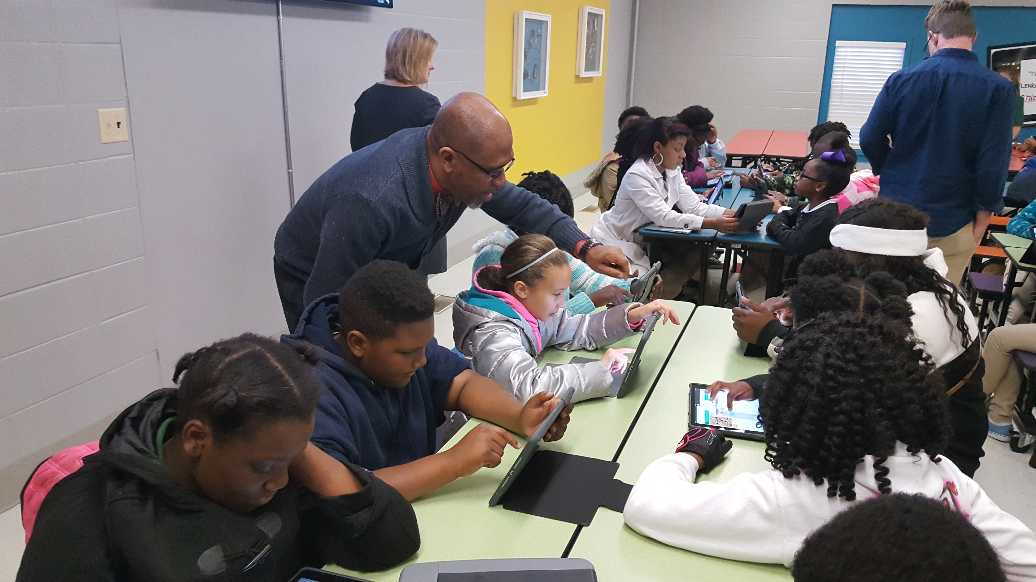
Achievements
Elementary
1 hour of CS per week including keyboarding, digital citizenship, coding, and robotics
K-12 Computer Science Standards approved
10-Year Strategic Plan for CS Education
Computer Science counts as graduation credit
CS courses/content available for every grade level
Over 130 districts/2000 teachers trained/over 120,000 students impacted so far
AP CSP can count as math or science credit
K-12 Computer Science teaching endorsements established
Over 2 million in grant funding for K-12 CS
Mississippi State University a Code.org Regional Partner
Mississippi is a member of ECEP Alliance
Middle School
Course 1
Cyber Foundations I
Course 2
Cyber Foundations II
Course 3
CS & Engineering
High School
Intro CS Course
Exploring Computer Science
AP
CSP
Game Design
Information Technology
Software Development
Cyber Security
Artificial Intelligence
Data Science
Future Pathways

Slide 4
Current Projects
Ongoing K-12 Teacher Training for middle and high school courses
Training elementary teachers and administrators to integrate computer science into other subjects
Developing K-12 curriculum for units in artificial intelligence and cybersecurity
Cybersecurity camps for middle and high school students
Developing a program to provide cybersecurity awareness and training for IT Directors in K-12 school districts
Partnering with other MSU units to build a cybersecurity certification program to re-skill and grow the Mississippi cyber workforce

Slide 5
Contact
Shelly Hollis
Director
Center for Cyber Education
shelly.hollis@cce.msstate.edu
662-816-7553

