Slide 1
Research Data Flow and Why it Matters
Kendall Blaylock
To change the “University Unit Name Here,”
you must modify the Master Slide. Go to your menu bar – select
the View tab, in the Master Views group, click Slide Master.
You’ll be able to select the text and modify it then. Hit save
and close out of Slide Master

Slide 2
Research Data
Every research project at MSU has some kind data associated with it.
Types of data related to research at MSU.
Administrative data
Internal project data
Experimentation data
Publication data
Much more….

Slide 3
Data Flow
Sometimes required as part of a project proposal.
Range from very simple to extremely complex.
Include any regular data information for the project.
What is the data?
What is the category of the data?
Where will the data be stored?
How will the data be transferred?
Other?

Slide 4
Data Requirements
When documenting data flow, consider any specialized data requirements.
Data handling requirements from the sponsor
Information Security requirements
Data retention requirements
Other

Slide 5
Scenario – Data Types
Proposal to create the perfect cowbell
Expected Project Data Types
Internal project management data (internal only)
Design and materials data (CUI)
Project reports (sensitive – limited dissemination)
Sponsor and internal team only
Publications (sensitive and public)

Slide 6
Scenario – Data Storage
Expected data storage
Specialized equipment storage
External USB drive
MSU network storage
MSU Team member workstations

Slide 7
Scenario – Data Transfer
Direct data transfer
Specialized equipment ←→ USB storage
USB storage ←→ Team Workstations
Remote data transfer
Team Workstation ←→ Team Workstation (via MSU Office 365)
Team Workstation ←→ MSU network storage
Team Workstations and MSU storage ←→ Sponsor (via email)
Team Workstations and MSU storage → Sponsor (via sponsor portal)

Slide 8
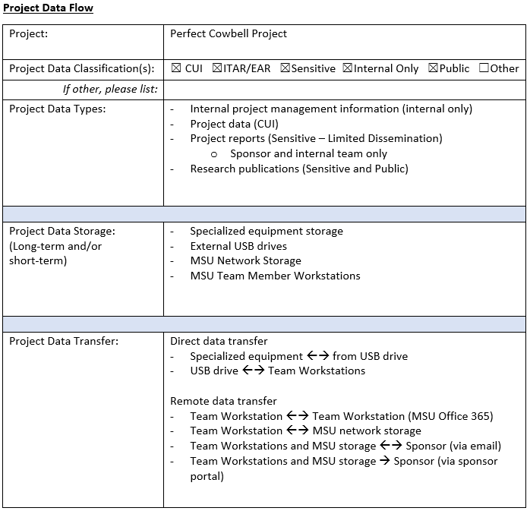

Slide 9
Cowbell Test Robot
MSU Cowbell Lab
More Cowbell Inc.
(Sponsor)
MSU Network Storage

Slide 10
Cowbell Test Robot
MSU Cowbell Lab
More Cowbell Inc.
(Sponsor)
Cowbell Cloud Co.
MSU Network Storage
What if we upgrade to Cowbell Test Robot 2.0?

Slide 11
Benefits
Better project data awareness for all team members.
Consistent data practices across departments.
IT support knowledge of unique technology requirements for a project.
Better strategy for technology implementation based on data flow needs.
Enhanced regulatory compliance awareness, documentation, and processes.
Improved disaster recovery for research at MSU.

Slide 12
Thank You
Kendall Blaylock
kendallb@hpc.msstate.edu

